Slide 2
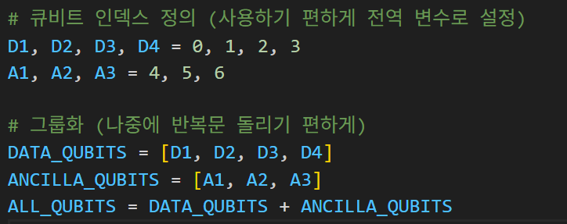
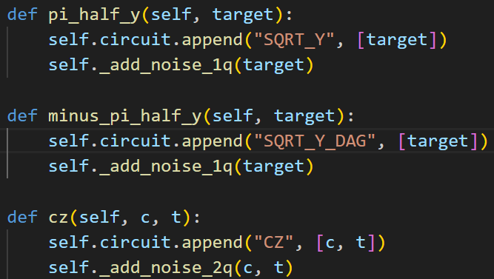
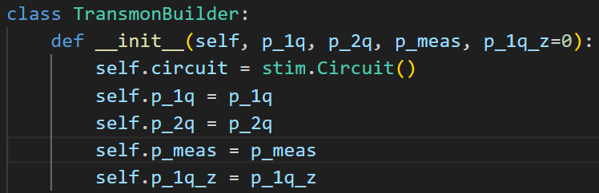
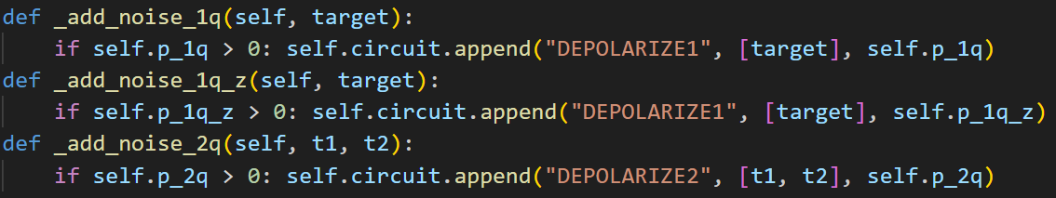
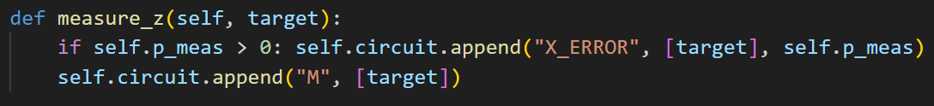

Slide 3
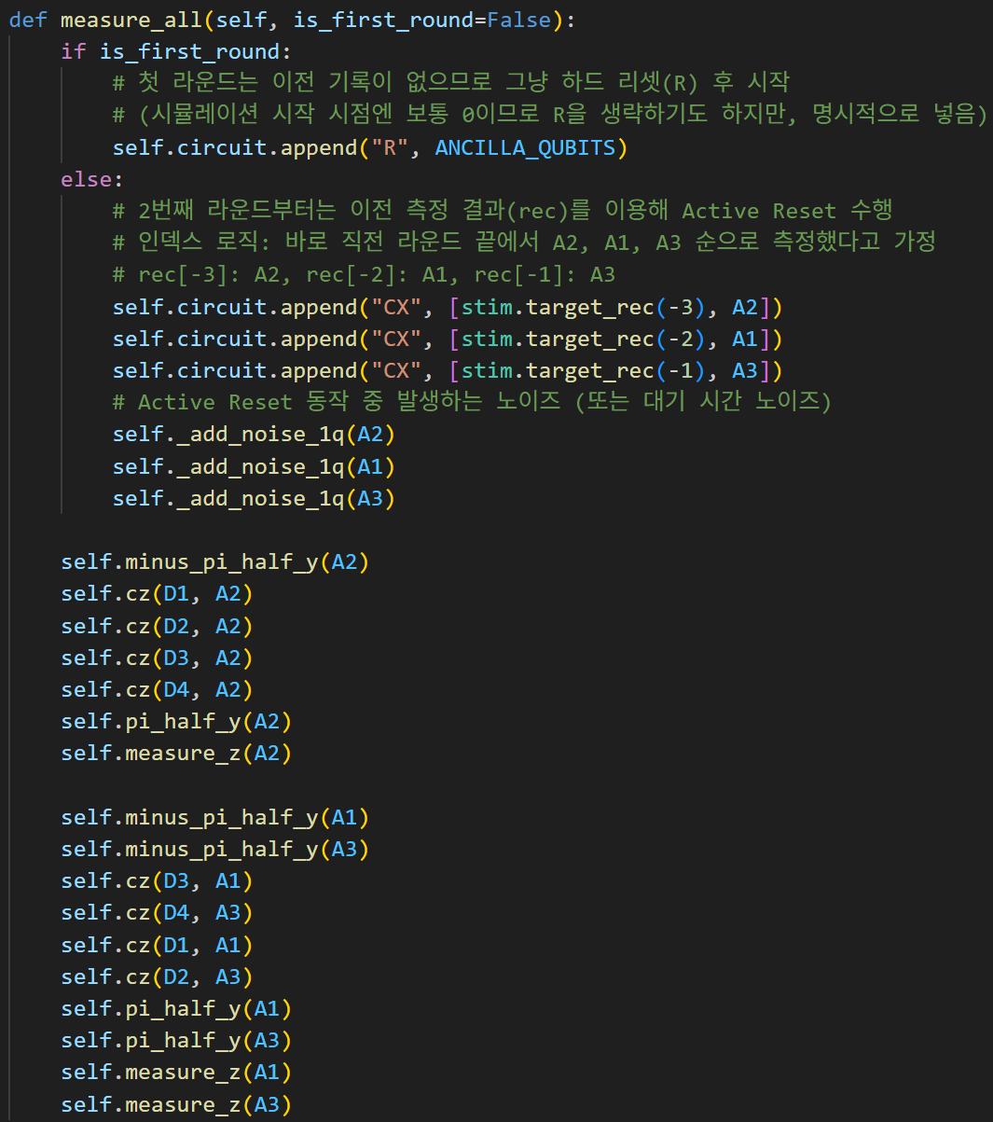
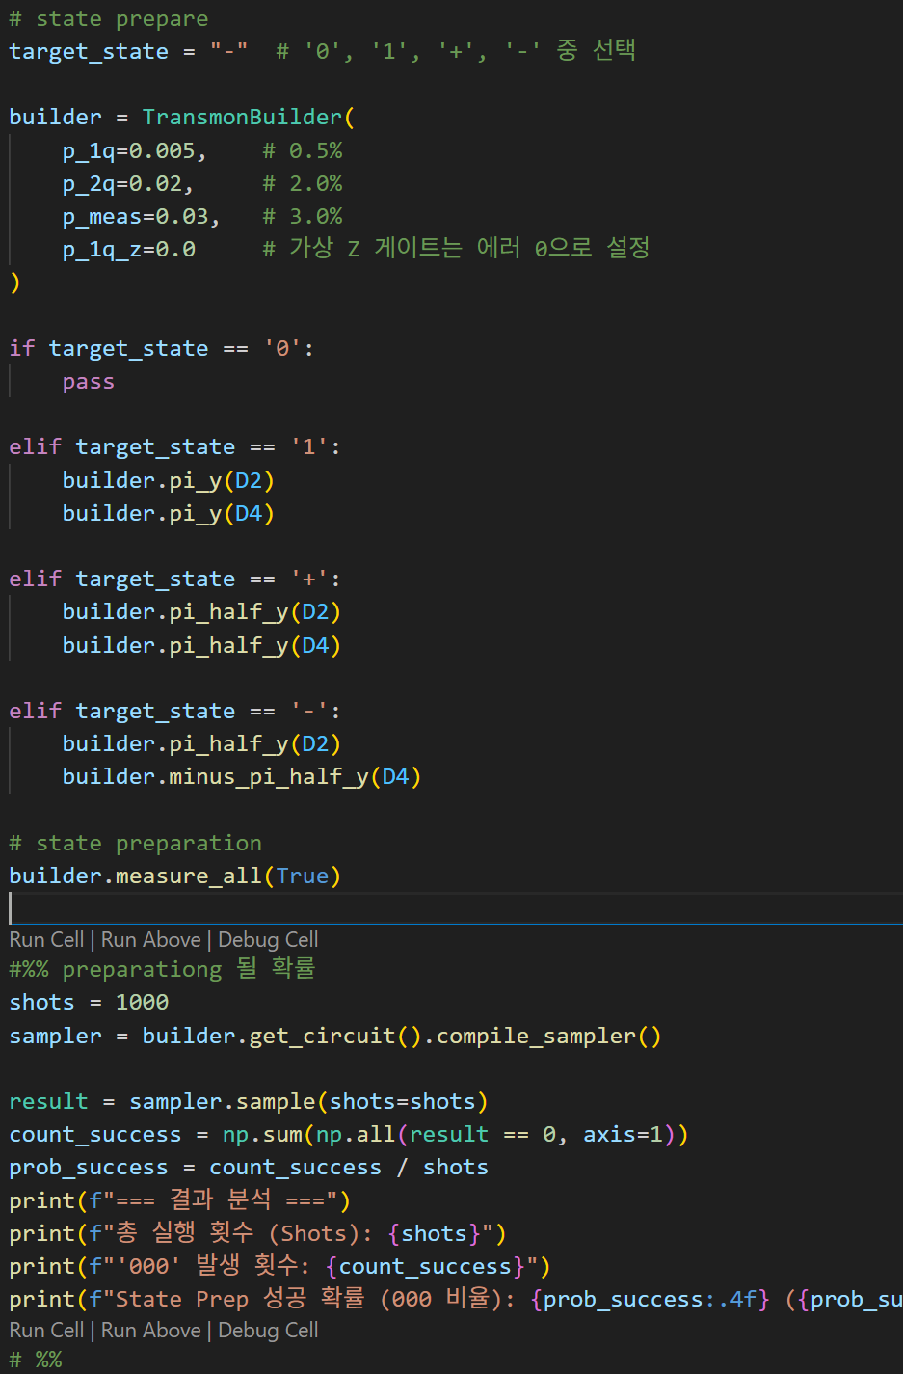
0 | 39.50%
1 | 40.10%
+ | 22.80%
- | 20.60%

Slide 4
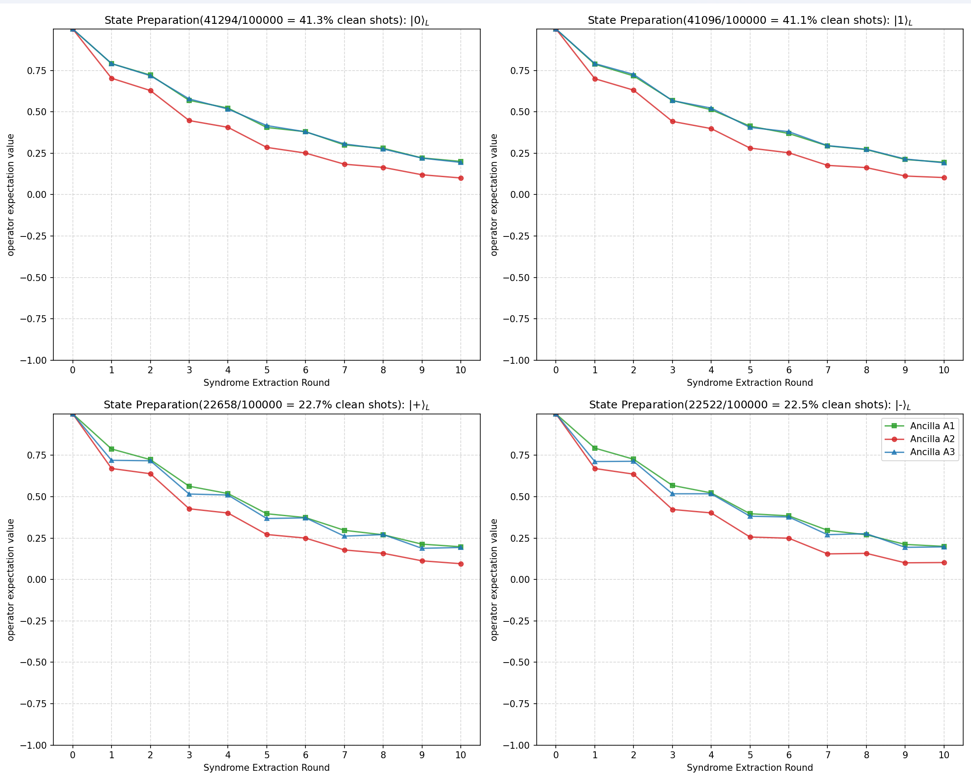
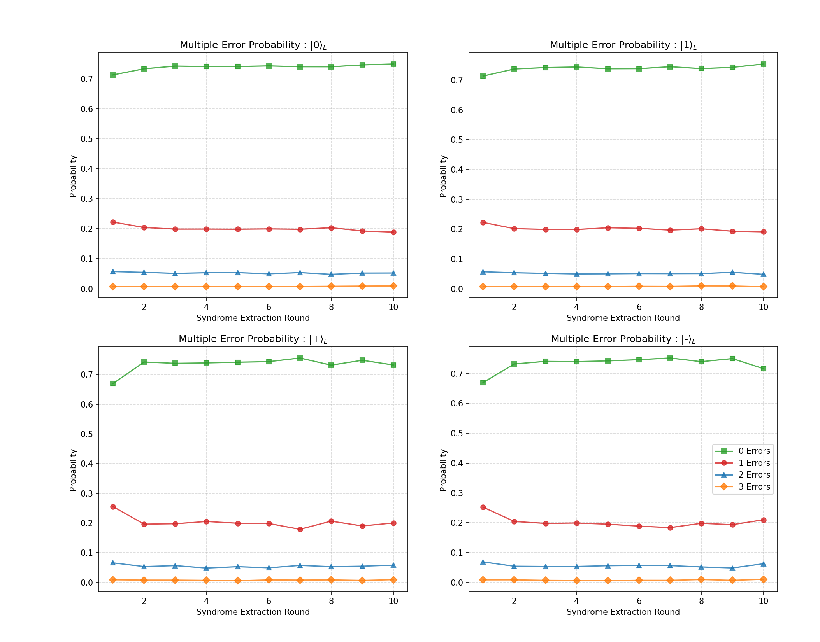
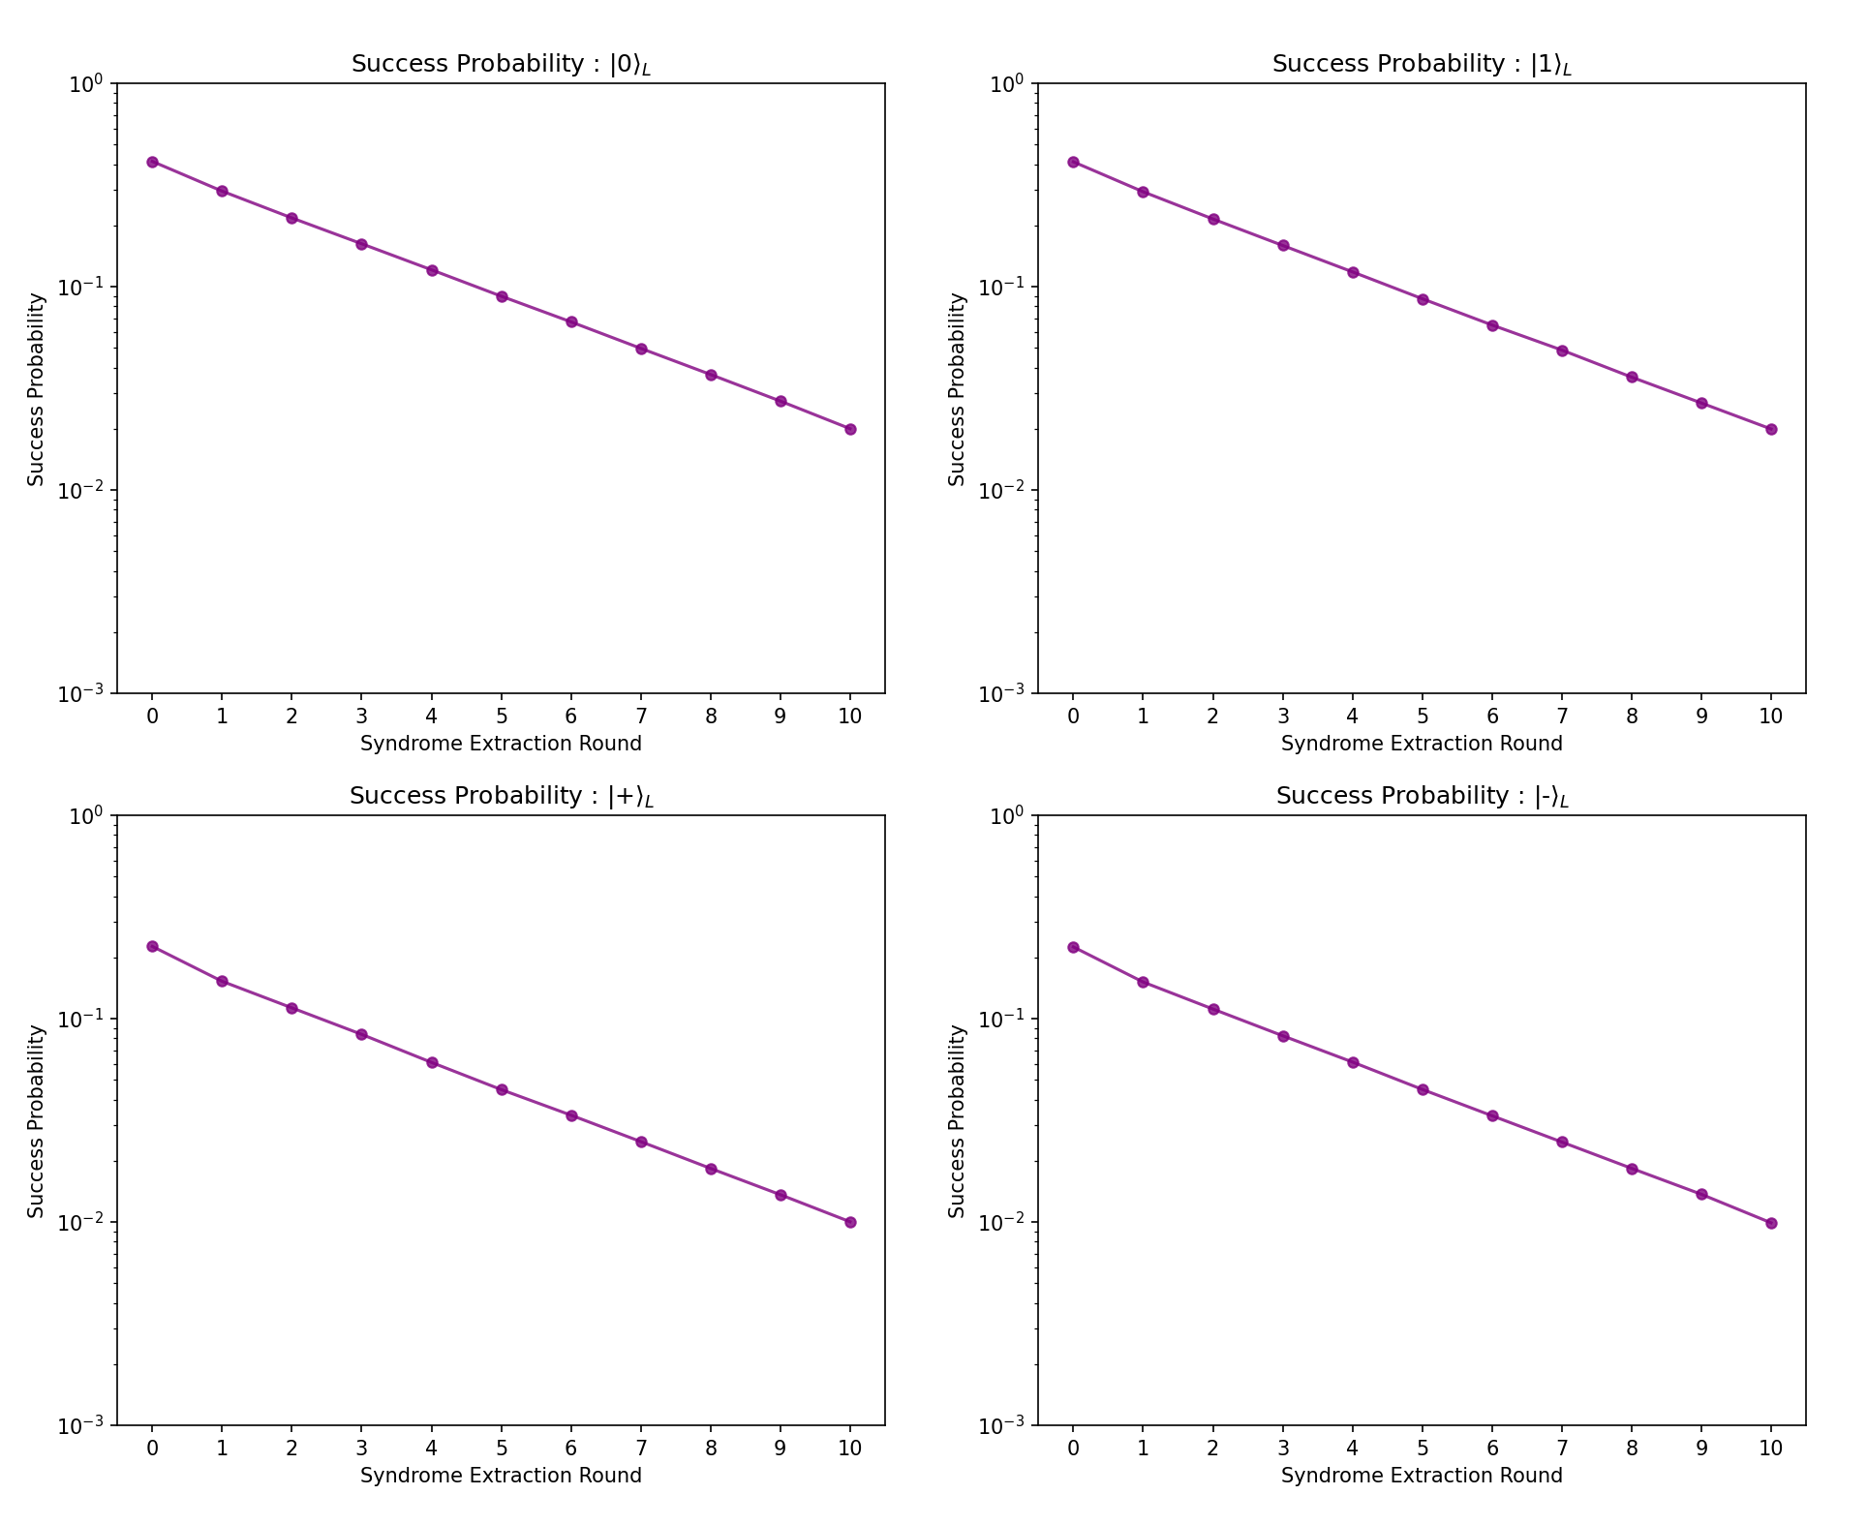

Slide 5
+state
NOISE_PARAMS = {
'p_1q': 0.001, 'p_2q': 0.005, 'p_meas': 0.02, # Readout Error 2%
'T1': 10, 'T2': 15, 'squence_time': 2
} shots=10000
physical probability PL : 0.566+0.000j
[[0.49691086 0.48190644]
[0.48190644 0.50308914]]

Slide 6
-state
physical probability PL : 0.565+0.000j
[[ 0.50353982 -0.48672566]
[-0.48672566 0.49646018]]

Slide 7
0state
Rho_L
physical probability PL : 0.577+0.000j
[[9.95667244e-01 8.66551127e-04]
[8.66551127e-04 4.33275563e-03]]

Slide 8
1state
Rho_L
physical probability PL : 0.577+0.000j
[[9.95667244e-01 8.66551127e-04]
[8.66551127e-04 4.33275563e-03]]

Slide 9
